Slide 1

WIPRO NGA Program – 25SUB4530_CP_JAVA
Capstone Project Presentation – 9th Feb & 10th Feb 2026
Project Title Here – To do / Task Manager Application
Presented by–Batch-13
Oviya babu & Sundara yoganand
www.rpsconsulting.in

Slide 2

Project Title Here – To do / Task Manager Application
Introduction :
Managing daily tasks manually can be confusing and time-consuming. Many users forget important activities or are unable to track their pending and completed tasks, which reduces productivity.
The Task Manager Application is created to solve this issue by providing a digital platform where users can add, edit, delete, and monitor their tasks in an organized manner.
The application offers a simple interface with features like due dates, task status, and priorities, helping users stay organized and complete their work on time.
2024 - RPS Consulting all rights reserved

Slide 3
To do /Task Manager Application
Problem Statement :
In daily life, individuals and professionals face challenges such as:
1)Difficulty tracking tasks manually
2)Forgetting deadlines and important activities
3)No centralized system to manage all tasks
4)Time wasted in planning and organizing work
5)Limited visibility of pending and completed tasks
A digital task management system is required to simplify task tracking and provide a clear overview of daily activities.
2024 - RPS Consulting all rights reserved

Slide 4
To do / Task Manager Application
Objectives:
➤ Primary Objectives
1)To build a web application that manages daily tasks efficiently
2)To provide clear visibility of pending and completed tasks
3)To help users organize and complete their work on time
➤ Secondary Objectives
1)Categorize tasks based on priority levels
2)Provide filters for easy task tracking
3)Generate simple task summaries
4)Ensure scalability and smooth deploymentbjectives
2024 - RPS Consulting all rights reserved

Slide 5
To do/Task Manager Application
Key Features :
The system provides the following features:
1)Add new tasks with title, description, due date, and priority
2)Edit or delete existing tasks
3)Mark tasks as completed or pending
4)Set priority levels (High, Medium, Low)
5)Filter tasks by status
6)View total, pending, and completed task counts
7)Expandable task view with detailed information
8)Responsive and user-friendly interface
2024 - RPS Consulting all rights reserved

Slide 6
To do/Task Manager Application
System Architecture :
The application follows a 3-tier architecture:
Presentation Layer
1)Angular frontend
2)User interface for managing tasks
3)Displays expense data
Application Layer
1)Spring Boot backend
2)REST APIs for task operations
Data Layer
1)PostgreSQL / H2 database
--Stores tasks with title, description, due date, status, and priority
Flow :
User → Angular UI → REST API → Database → Response → UI
2024 - RPS Consulting all rights reserved

Slide 7
To do/ Task Manager Application
Technology Stack :
Frontend
1)Angular framework
2)TypeScript
3)HTML, CSS
4)Bootstrap for UI styling
5)Angular services for API calls
Backend
1)Spring Boot
2)Spring Data JPA
3)REST API architecture
4)Maven build tool
Database
1)MYSQL (production)
2)H2 (development/testing)
DevOps
1)Docker for containerization
2)Azure App Service for hosting
2024 - RPS Consulting all rights reserved

Slide 8
To do / Task Manager Application
Function Module :
1. Expense Module
1)Add new task
2)Update task details
3)Delete task
4)View task list
2. Priority Module
1)Set task priority(High, Medium, Low)
2)Assign priority to tasks
3)Manage priority levels
3. Status& Reporting Module
1)view total tasks
2)Filter by status(pending/completed)
3)Filter by due date
4)Task summary dashboard
2024 - RPS Consulting all rights reserved

Slide 9
To do /Task Manager Application
User Interface:
The Angular frontend provides:
1)Dashboard page
2)Add task form
3)Task list view
4)Filter options (All, Pending, Completed)
5)Summary section
6)Priority and due date indicators
The UI updates in real time when tasks are added, edited, or deleted.
Application Workflow:
User opens application:
1)User opens application:
2)User logs in to the system
3)User adds a new task
4)User sets priority and due date
5)Data sent to backend API
6)Backend stores task in database
7)Dashboard updates automatically
8)User views or manages tasks
This ensures smooth and real-time task management.
2024 - RPS Consulting all rights reserved

Slide 10
To do/Task Manager Application
DevOps & Deployment :
→Docker
1)Containerizes frontend and backend
2)Ensures consistent runtime environment
across systems
→Azure
1)Hosts backend APIs
2)Hosts Angular frontend
3)Supports scalability and remote access
→Benefits:
Simple and fast deployment
Cloud-based hosting
Scalable architecture
Easy maintenance and updates
2024 - RPS Consulting all rights reserved

Slide 11
To do/Task Manager Application
Advantages & Limitations :
Advantages :
1)Easy and user-friendly interface
2)Helps organize daily tasks efficiently
3)Real-time task updates
4)Priority-based task management
5)Scalable architecture
6)Cloud-ready deployment
Limitations :
1)Basic authentication(initial version)
2)Single-user focused system
3)Limited analytics or reporting
4)No mobile app version yet
2024 - RPS Consulting all rights reserved

Slide 12
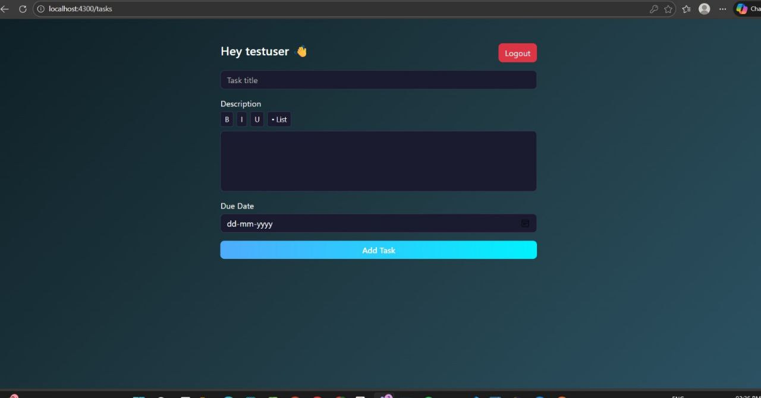

Slide 13
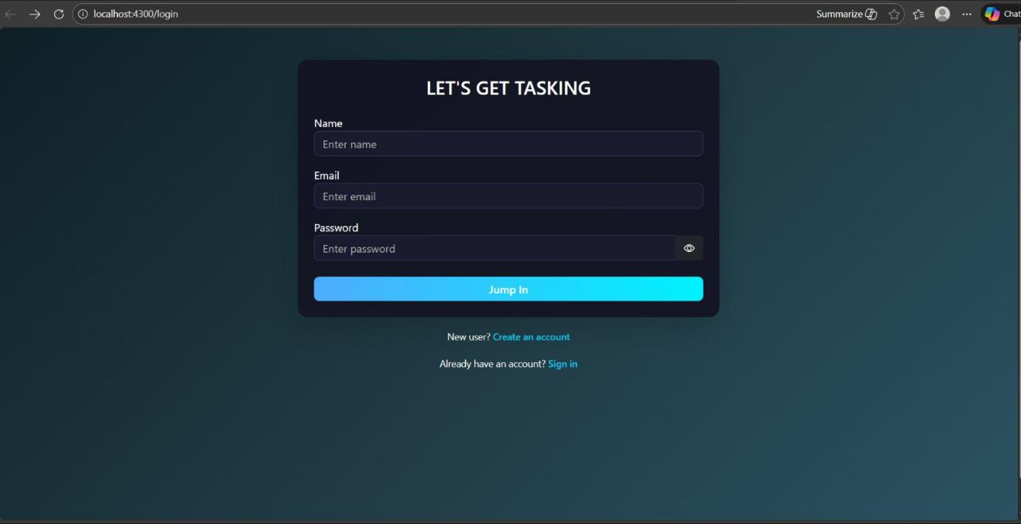

Slide 14
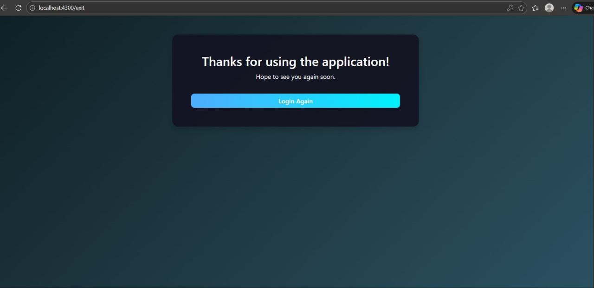

Slide 15
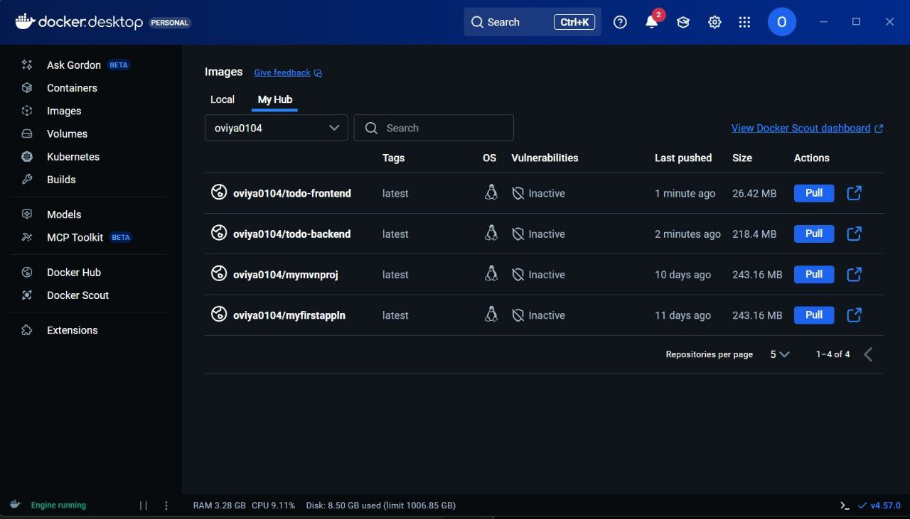

Slide 16
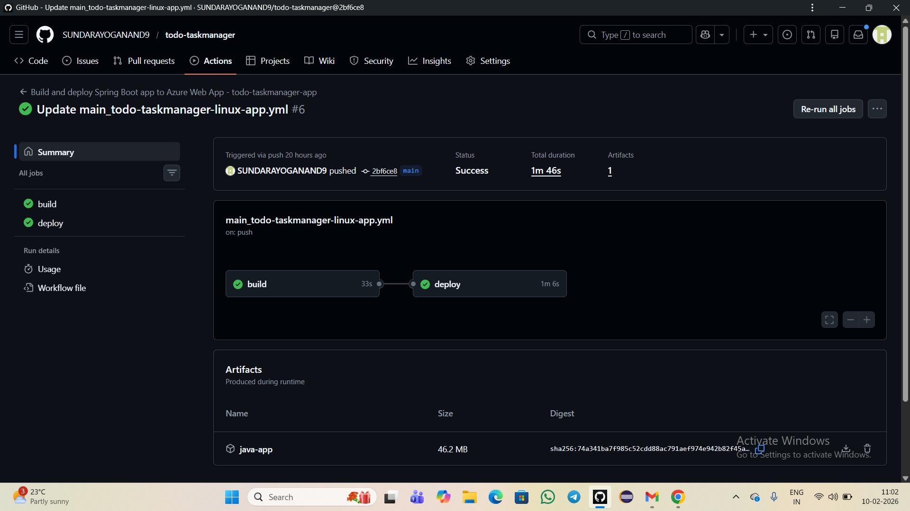

Slide 17
Conclusion:
1)Developed a full-stack task management application
2)Used Angular for frontend and Spring Boot for backend
3)Implemented add, edit, delete, and status features
4)Integrated REST APIs for communication
5)Containerized the application using Docker
Thank you

